Slide 1


TFVC user

Slide 2

Team Project
Team 1
Team 2
TFVC
Team 3
Team Project
Local
Remote
Team 1
clone
Team 2
Git
Git
Team 3

Slide 3
Team Project
Team 1
Team 2
Git
Git
Git
Team 3

Slide 4



Dave – Development Lead
Doris – Developer
Christine – Tester

Slide 5
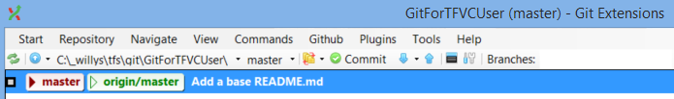
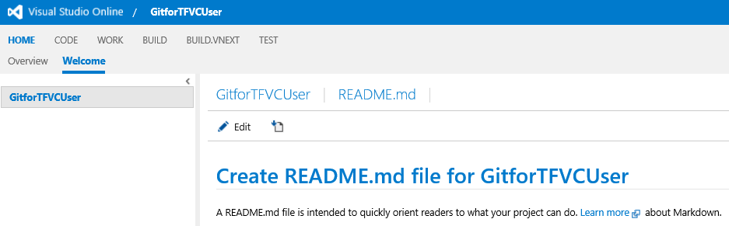
❶
❷

Slide 6
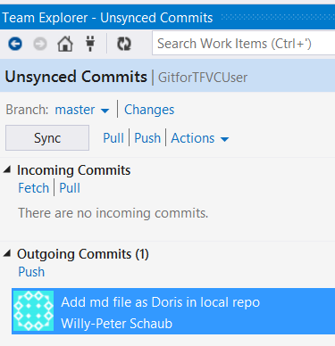
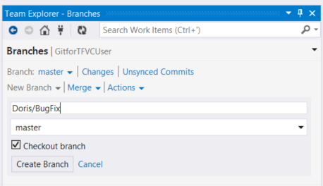
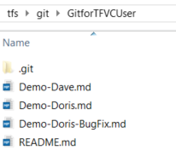
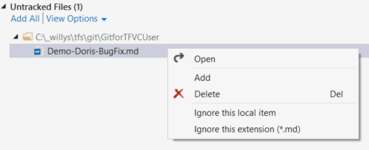
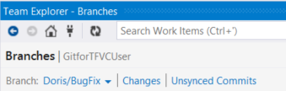
❷
❶
❶
❷
❸
❶
❷

Slide 7
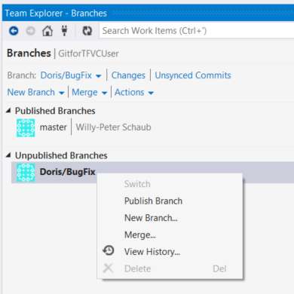
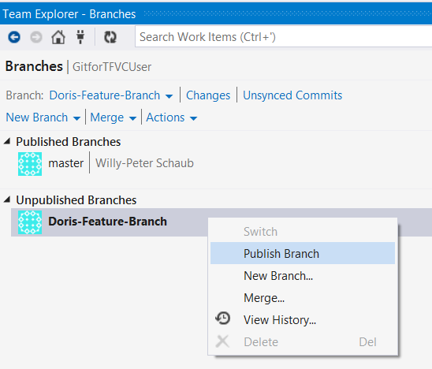
❶
❷

Slide 8
Origin master
A
Doris master
Dave master
Origin master
Origin master
Doris master
A
A
Origin master
B
A

Slide 9
Doris master
origin master
B
A
isolated
Doris master
Origin master
C
A
B
Dave master
Dave master
Doris master
Origin master
A
B
C

Slide 10
Doris master
Origin master
A
B
C
E
Doris BugFix

Slide 11
Doris master
Origin master
A
B
C
D
E
F
Doris Feature

Slide 12
Doris master
B
Origin master
A
D
C
Dave master

Slide 13
B
Doris master
Origin master
A
D
E
C
Dave master

Slide 14
head
Origin master
Topic Branch
A
B
C
A
B
branch
C
master
Topic 1 Branch
C
E
Topic 1
branch
Topic 2 Branch
Origin master
D
F
G
Topic 2
A
B
Main

Slide 15
❷
❶
❶
❷
❸
❶
❷

Slide 16
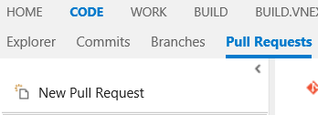
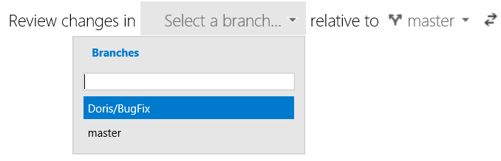
❶
❷
❸

Slide 17
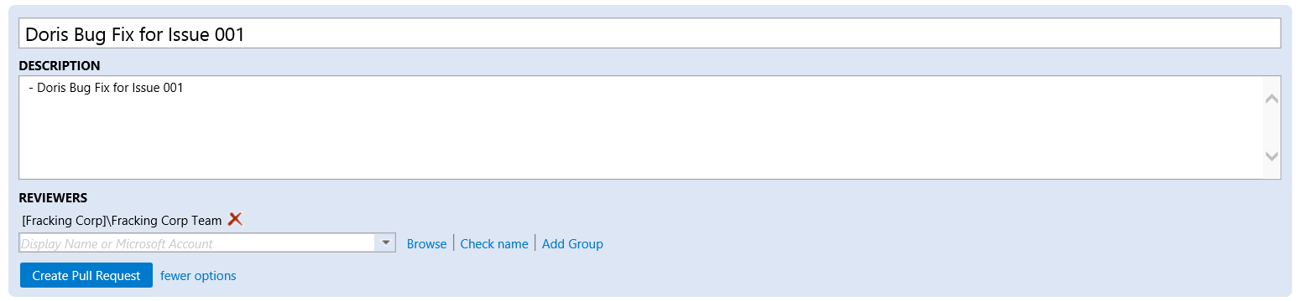
❶
❷
Dave – Development Lead
❸

Slide 18
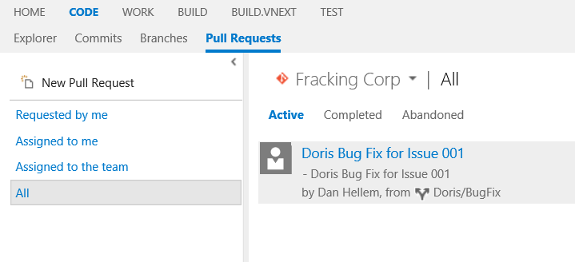

GitForTFVCUser

Slide 19
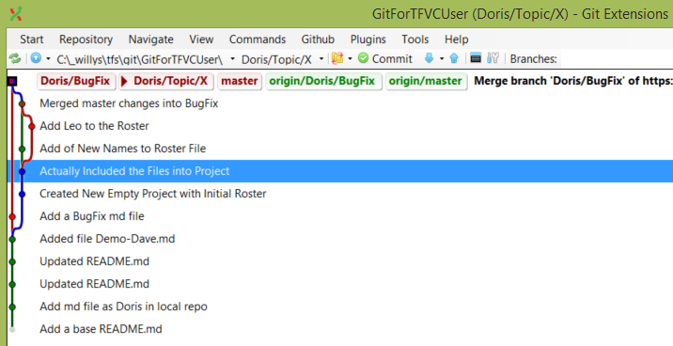
Topic X
Origin master
H
A
B
C
D
E
G

Slide 20
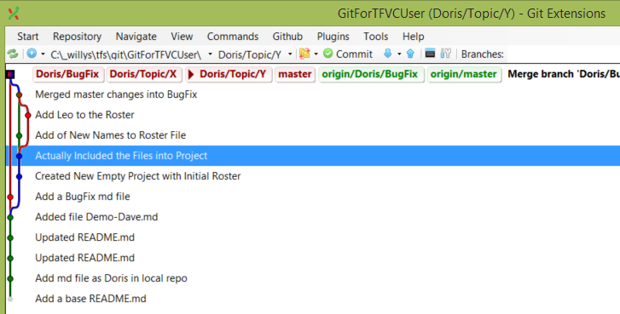
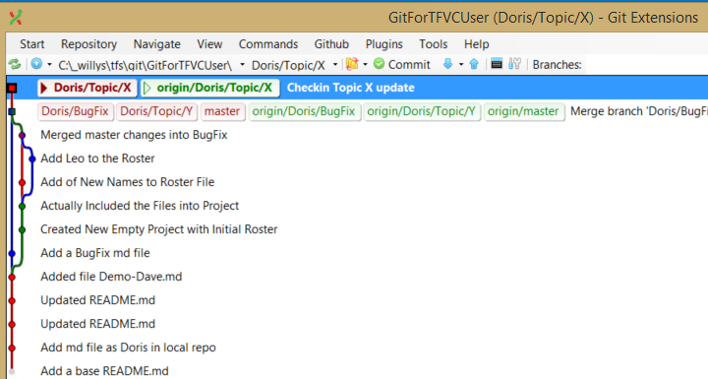
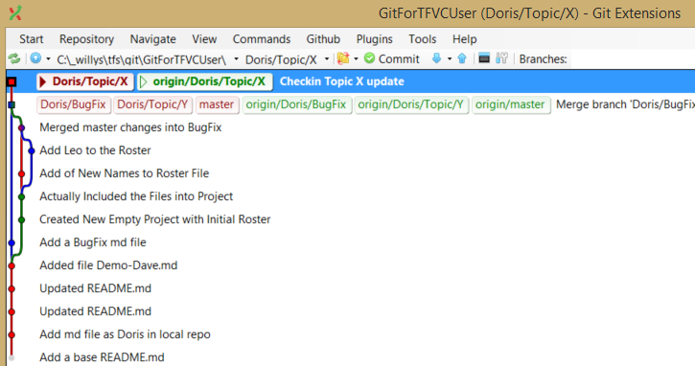
Topic X
Origin master
H
A
B
C
D
E
G
I
Topic Y

Slide 21
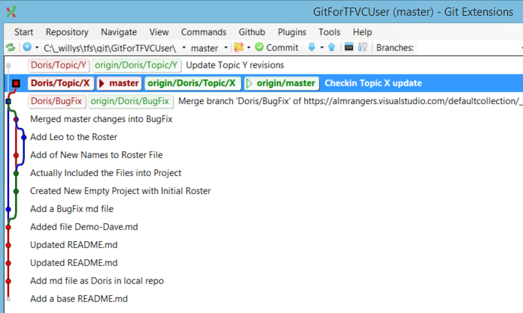
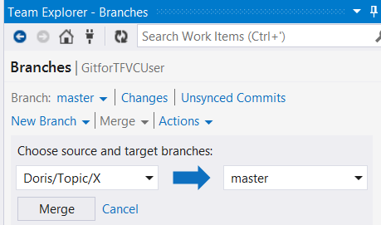
H
Origin master
A
B
C
D
E
G
J
I
Topic Y

Slide 22
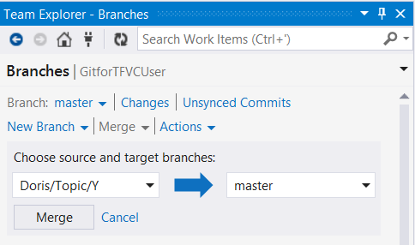
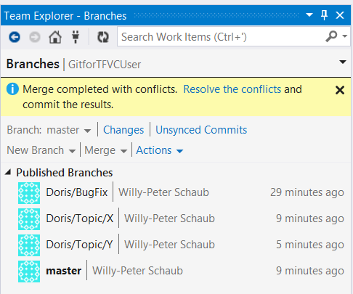
H
Origin master
A
B
C
D
E
G
J
K
I
❶

Slide 23
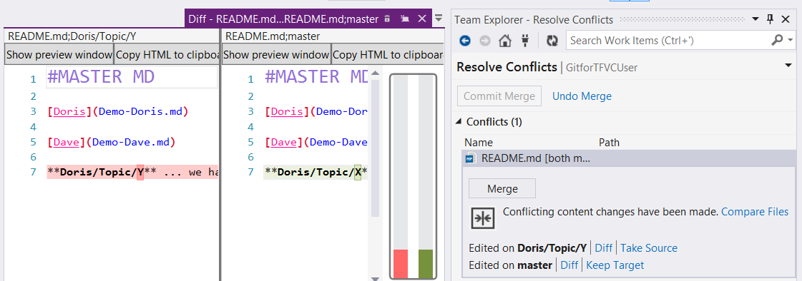
❹
❷
❸

Slide 24
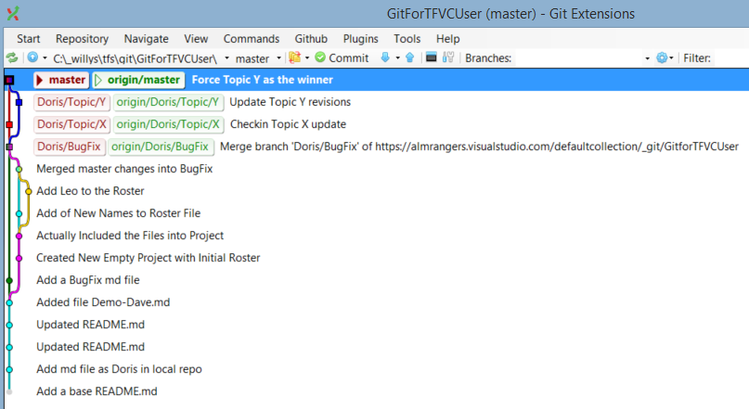

Slide 25
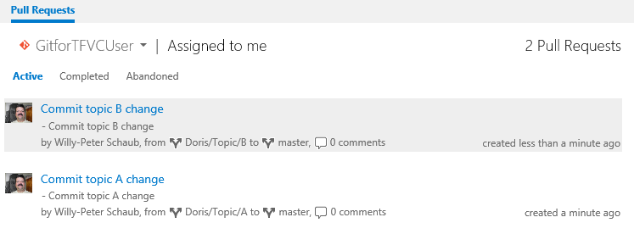

Slide 26
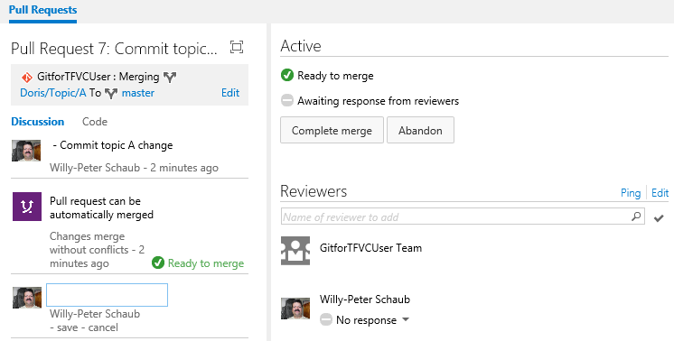
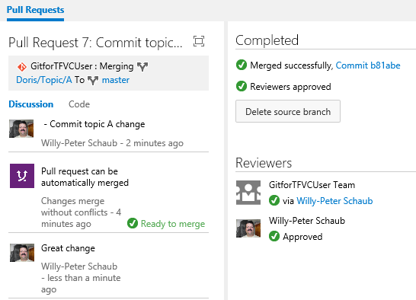

Slide 27
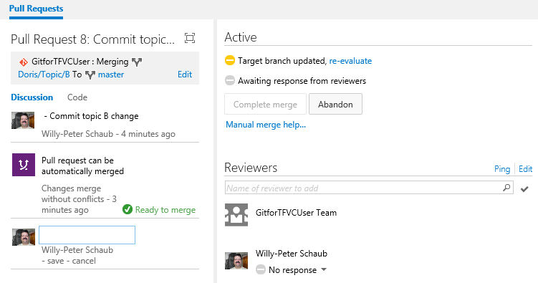

Slide 28
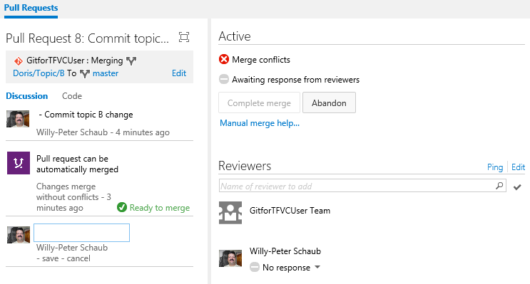
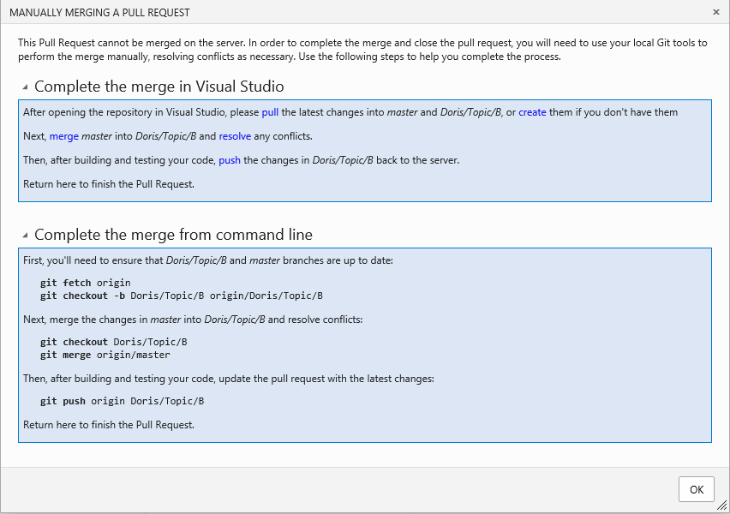
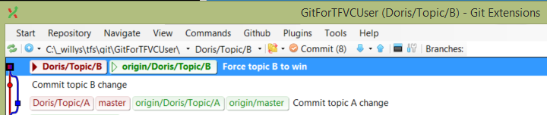

Slide 29
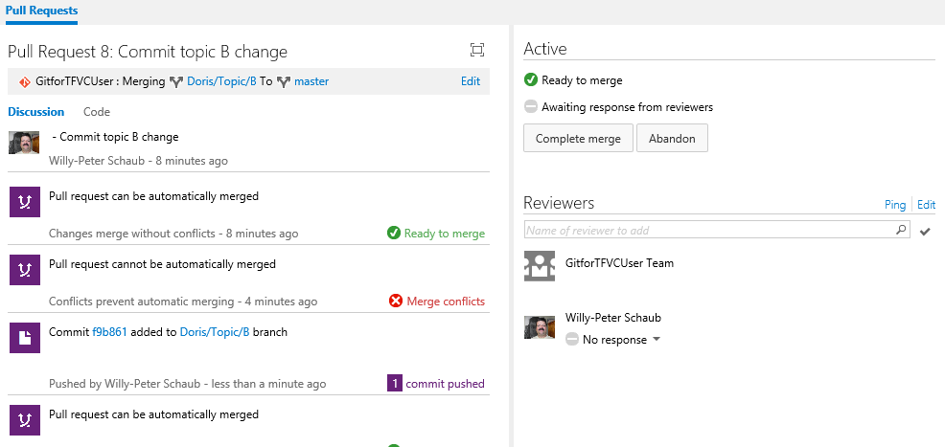
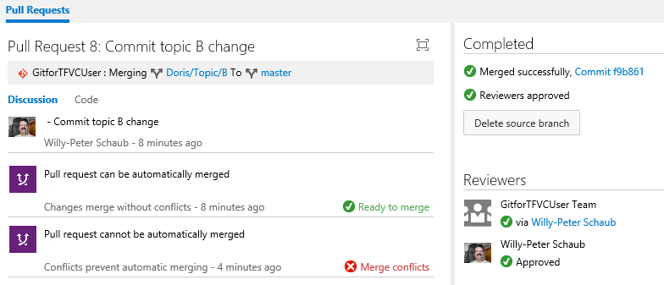
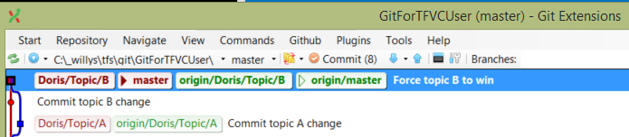

Slide 30
Visual Studio Team Services account
DefaultCollection
FabrikamOld Team Project
Fabrikam Team Project
Git
MigrationDemo
move
Git
Fabrikam
TFVC
Fabrikam
Git
MigrationDemo

